Slide 1
BRILLIANT BRAINS
BUSINESS Model-:

Slide 2
PURPOSE ---:
Many parents are now realizing the importance of overall development for their children that school alone are unable to provide and there is also an increasing need for specialized coaching to help their children skills .
My Purpose is to serves expertized peoples coaching to help children in excelling their academics goals .
Second Purpose is to provide side income to any person who is expert on any subject or skill can help children in their studies and can earn part-time /full-time money in their free time or during in their College days .

Slide 3
NEED --:
Different tools help different people ace the tests
To upskill the children knowledge
Providing online mode of coaching so they can also guided by their parents
Some children who are unable to cover up with school studies can easy be guide
Want to give part time and full time opportunity to those who want to earn part time / full time income by specified in particular skills
Proven a helping hands to working Parents.
In this education based society people to get degrees to get ahead.

Slide 4
TARGET AUDIENCES --:
Children up to class 1 to 12th
Undergraduate
Post graduate
People of ages who want to learn new skills and upgrade themselves

Slide 5
Revenue Model ---:
As 86% of revenue market covered by coaching institutions and online Edtect companies
Most parents thinks that they are ill-equipped or having lack time to teach their children so they hand over to coaching centers.
Teachers can update their profile and steam and can charge upto thousand depending on their skills and experiences
Long- term model -----: As Coaching industries are growing amidst the general support with school education, youngsters are also engaging with coaching centres to earn part time income also while completing their studies . Parents are spending 1/3rd of their monthly income in coaching institutes. 1000 to 4000 per hour are charging rate by tutors one basis ,while group tuition costs Rs 1000 to 6000 per month . The survey revealed estimate 78 per cent . Rs 5000 for the tuition of secondary level child monthly.

Slide 6
CREATING BLUE MOON PHRASE
As there are many possible business running in the market but unfortunately everyone running to make money while only selling expensive courses not acknowledging different children's problem and concentration
In many Edtect companies decided there prices but in our business teachers can rate their skills prices according to there capability. As to be a part of our home tutor online business they have to apply on our sites and then fill the form and education details and can fix prices according minimum pay rate and student can choose teachers according their requirements, then can start virtual online class by 2 children in starting . When they can rate teachers and by rating they can increase there prices.

Slide 7
EXPANSION MODEL ---:
This is a personal tutoring online business. Brilliant Brains will be able to make enough during the school year to sustain his needs when June July and august come around and students are fewer.
The rent and expenses listed are for him to pay his rent and to eat etc. between group sessions.
Tutoring Service has identified several target market segments that will be pursued. The largest segment is the Intermediate and Management business students. Brilliant Brains has close relationships with most of the professors of the business program, allowing Brilliant Brains to tailor the tutoring to the specific course material as well as receive referrals from said professors.

Slide 8
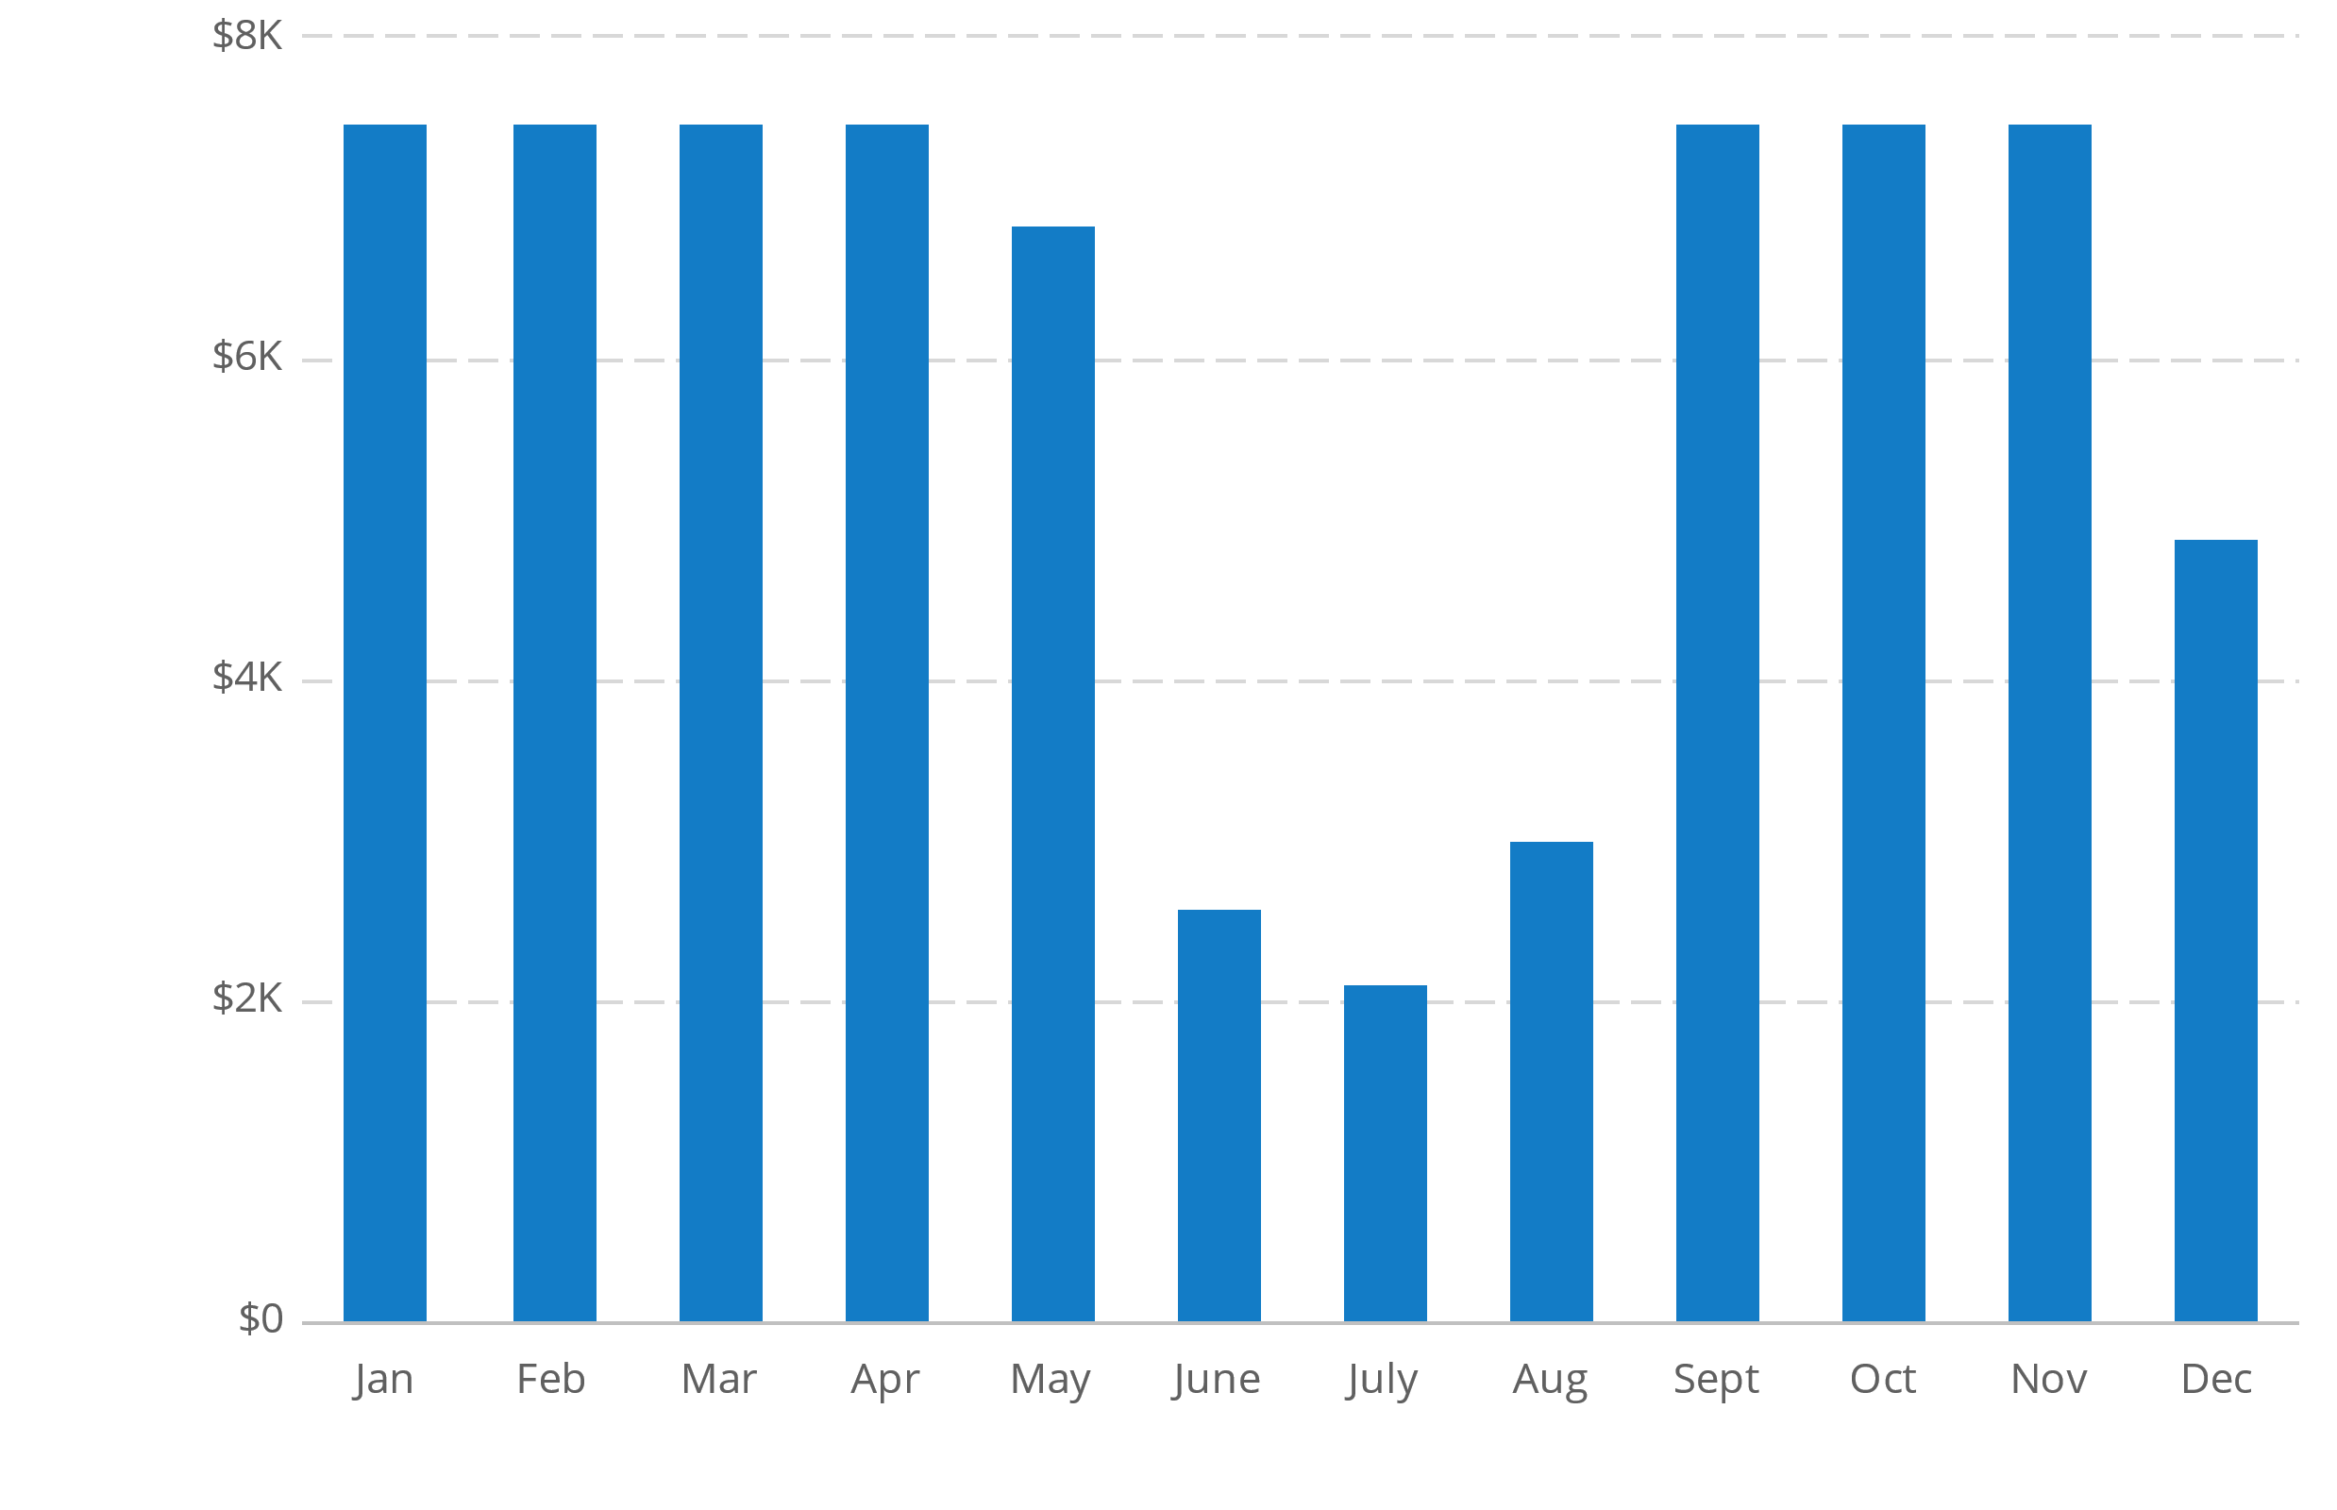
Revenue by Month

Slide 9
INVESTMENT-----:
The tutoring business will need about Rs 5,000 to start. Costs include gas and transportation to meet with students away from his home and occasional handouts. And online virtual classes expansies.
Brilliant Brains has reserved a room in his house and an office/meeting room for his business. Additionally, Brilliant Brains incurs Internet service provider fees, and every two years a new computer.

Slide 10
2022 | 2023 | 2024
Revenue | Rs71,830 | Rs72,790 | Rs73,750
Direct Costs | Rs3,592 | Rs3,639 | Rs3,688
Gross Margin | Rs68,239 | Rs69,151 | Rs70,063
Gross Margin % | 95% | 95% | 95%

Slide 11
COMPITITORS ---:
Tutoring has been around as long as students. And as long as students get in over their head, they will need tutors to help them catch up and keep up with their classmates. Some materials just need to be explained in different ways for them to make sense.
However, while the need for tutoring exists, the bulk of tutoring taking place in the market is very limited and unorganized. What sets this company apart is its experience and the attention paid to individual needs of students.
Naming Competitors are – Akash , Extra marks , Vedante etc

